Slide 1
8085 Microprocessor Architecture
Prepared By: Mrs. Sneha J. Patel

Slide 2
Architecture of 8085 Microprocessor
The internal architecture of the 8085 microprocessor determines how and what operations can be performed with the data operations are,
Store 8-bit data.
Perform arithmetic and logical operations.
Test for conditions.
Sequence the execution of instructions.
Store data temporarily in read write memory called stack.

Slide 3
Features of 8085
Manufactured using NMOS technology.
Available in a 40-pin Dual In-line Package (DIP).
8-bit data bus
16-bit address bus, which can address up to 64KB(65,536 bytes) of memory.
A 16-bit program counter
A 16-bit stack pointer
Six 8-bit registers arranged in pairs: BC, DE, HL
Requires &plus;5V supply to operate at 3.2 MHZ single phase clock
5 Interrupts: TRAP, RST 7.5, RST 6.5, RST 5.5, and INTR.

Slide 4
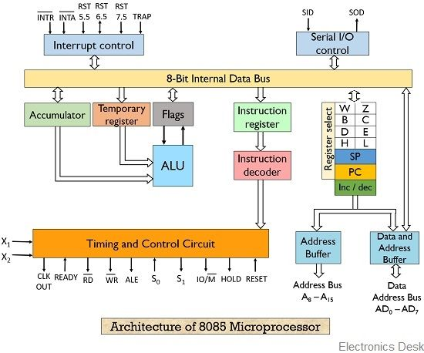

Slide 5
The 8085 has 6 general purpose registers to store 8-bit data during program execution.
These 6 registers are identified as B, C, D, E, H and L.
They can be combined as register pairs BC, DE and HL to perform some 16-bit operations.
These registers are programmable. It can use to load or transfer data from the registers by using instructions.

Slide 6
Accumulator
The accumulator (A) is an 8-bit register that is part of ALU.
It is used to store 8-bit data and to perform ALU operations.
The result of an operation is stored in Accumulator.
The Accumulator is identified as register A.
The data on which operations is to be performed is operand. One of the operands must be Accumulator.

Slide 7
Program Counter (PC)
This 16-bit register deals with sequencing the execution of instructions.
This register is a memory pointer. Memory locations have 16-bit address.
The microprocessor uses this register to sequence the execution of the instructions.
The function of the program counter is to point to the memory address from which the next byte is to be fetched.
When a byte is being fetched, the program counter is automatically incremented by one to point to the next memory location.

Slide 8
Stack Pointer (SP)
The stack pointer is also a 16-bit register, used as a memory pointer.
It points to a memory location in R/W memory, called stack.
The beginning of the stack is defined by loading 16- bit address in the stack pointer.

Slide 9
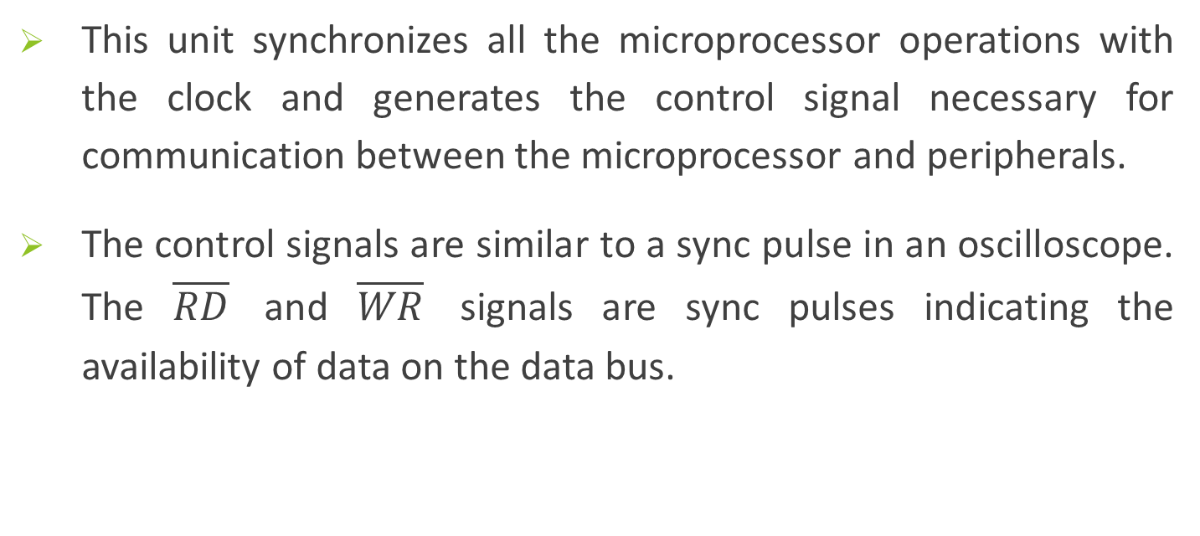
Timing and control unit
This unit synchronizes all the microprocessor operations with the clock and generates the control signal necessary for communication between the microprocessor and peripherals.
The control signals are similar to a sync pulse in an oscilloscope. The $\overline{RD}$ and $\overline{WR}$ signals are sync pulses indicating the availability of data on the data bus.

Slide 10
Instruction register and Decoder
The instruction register and decoder are part of the ALU.
When an instruction is fetched from the memory it is loaded in to the instruction register.
The decoder decodes the instruction and establishes the sequence of events to follow.
The instruction register is not programmable and cannot be accessed by any instruction.

Slide 11
Register Array
There are two additional registers called temporary registers W and Z, which are included in the register array along with programmable registers namely B, C, D, E, H, L, SP and PC.
These registers are used to hold 8-bit data during the execution of instructions. However, they are used internally by microprocessor, they are available to the program.

Slide 12
MUX / DEMUX unit
This unit is used to select a register out of all the available registers.
This unit behaves as Multiplexer (MUX) when data going from the register to the internal data bus.
It behaves as Demultiplexer(DEMUX) when data is coming to a register from the internal data bus of the processor.
The register select will behave as the function of selection lines at the Mux / Demux.

Slide 13
Address Buffer
This is an 8-bit bi-directional buffer.
It is used to drive multiplexed address/data bus. i.e., low order address bus (A₇-A₀) and data bus (D₇-D₀).
It is also to tri-state the multiplexed address/data bus under certain conditions such as reset, hold, halt and when the bus is not in use.

Slide 14
Incrementer/Decrementer address latch
This 16-bit register is used to increment or decrement the contents of program counter or stack pointer as part of execution of instructions related to them.

Slide 15
Flag register
The ALU includes five flip-flops, which are set (or) reset after an operation according to data condition of the result in the accumulator and other registers.
They are called Sign (S), Zero (Z), Auxiliary Carry (AC) , Parity (P) and Carry (CY) flags.
Their bit positions in the flag register are shown in Fig. The microprocessor uses these flags to test data conditions.
These flags have critical importance in the decision-making process of the microprocessor.

Slide 16
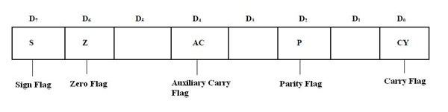
S (Sign Flag):
• It holds the arithmetic sign of the result after arithmetic or logic instruction executes.
• If S = 1, the sign bit (leftmost bit of a number) is set or negative and if S = 0, the sign bit is cleared or positive.
(2) Z (Zero) Flag:
• This flag indicates whether the result of mathematical or logical operation is zero or not.
• If the result of the current operation is zero, then this flag will be set, otherwise reset.

Slide 17
(3) AC (Auxiliary Carry) Flag:
• It shows carry propagation from D3 position to D4 position.
• AF (Auxiliary carry Flag): It holds the carry (half-carry) after addition or borrows after subtraction between bit positions 3 and 4 of the result in a BCD operation.
• If carry or borrow generated to D3 and to pass to D4, then AC flag is set otherwise reset.

Slide 18
(4) P (Parity Flag):
• It is the count of ones(1s) in a number expressed as even or odd.
• It is logic 0 for even parity (i.e. even number of 1s)
logic 1 for odd parity (i.e. odd number of 1s).
(5) C (Carry) Flag:
• During an addition or subtraction operation, if carry or borrow is generated then this flag bit will be set ,otherwise it is reset.

